Slide 1
Development of a National Competence Assessment tool to assess clinical practice of undergraduate student midwives in the ROI
Dawn Johnston, Director of Midwifery, NMBI
Dr Denise Lawler, NMBI Board member/ Healthcare Inspector, HIQA

Slide 2
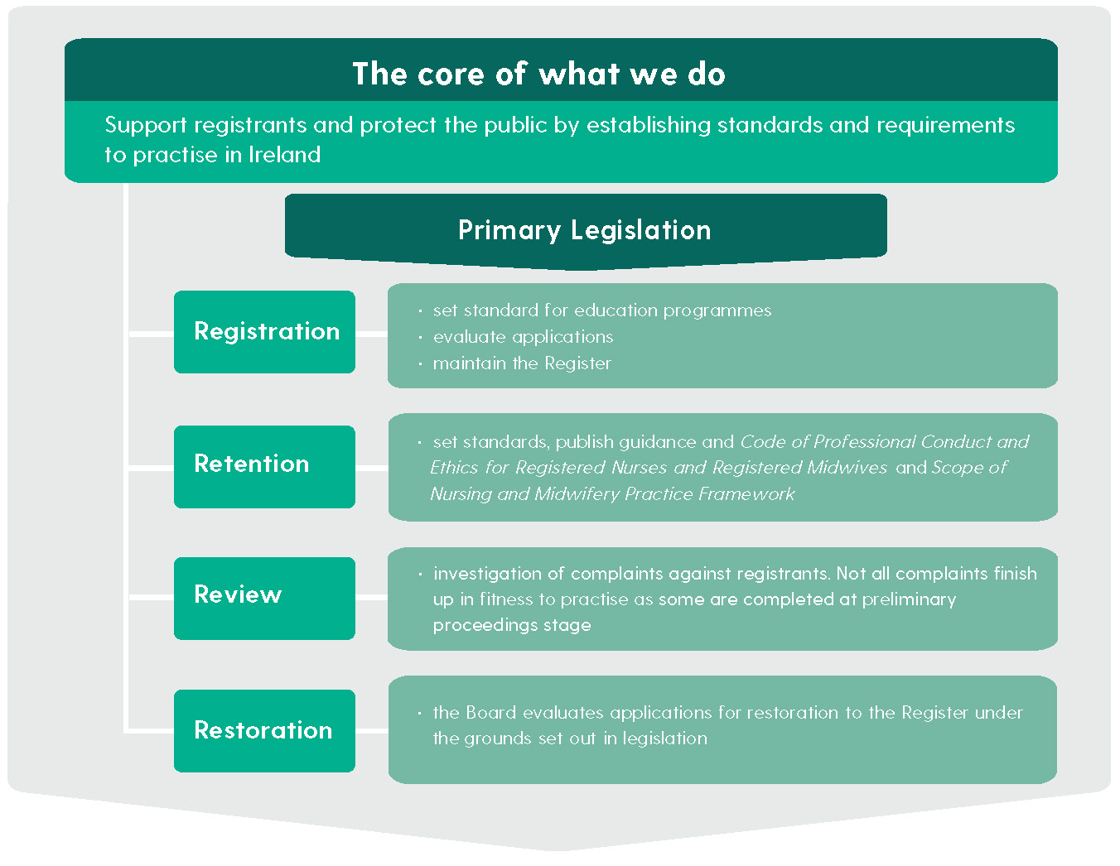
NMBI – Our values and our mission
We are
the regulatory body for
the professions of NURSING and MIDWIFERY
in Ireland
Our Vision
is to provide leadership to registered nurses
and midwives in delivering safe care through innovative and proactive professional regulation.
Our Mission
is to protect the public and the integrity of the professions of nursing and midwifery through the
promotion of high standards of education, training,
and professional conduct.

Slide 3


Slide 4
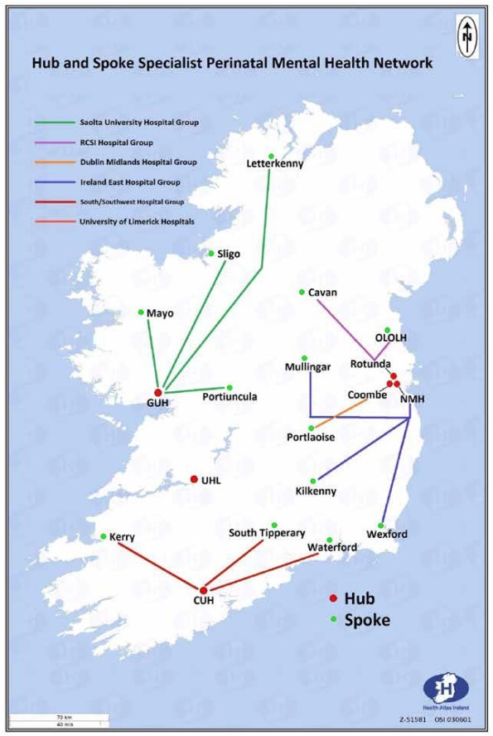
Maternity Services in the Republic of Ireland
19 Maternity Units - Annual birth rate 60,000
Birth rate ranges from 1,200 to 9,000 per year
6 HEIs (Dublin X 2, Cork, Limerick, Galway, Louth)
Yearly 180 Student Midwives admitted to the undergraduate and postgraduate programmes
Supported, assisted and specialised pathways of care
National Maternity Strategy (2016)
Standards and Requirements Midwifery Education Programme (NMBI 2016)

Slide 5

Background
National Competency Tool for students midwives
  - aim national standardisation
6 HEIs with 6 competency tools assessing same competencies
Very short time scale to develop new competency tool
A tool is required for:
  each year of the undergraduate education programme
  each part of the postgraduate education programme

Slide 6

How was it achieved?
Working Group formed (reported to the Education and Training Committee)
Working Group includes:
Representatives from each of the 6 HEIs
Representatives from clinical sites linked to the 6 HEIs
Newly qualified midwife
Nursing and Midwifery Board of Ireland member

Slide 7
How was it achieved?
  Met monthly in Dublin
  Significant work load as member also had a day job
  Agreed that each HEI would lead on one of the five principles of competency
  Years 1,2 and 3 implemented and evaluated
  Year 4 is currently being implemented
  Evaluation of the tool for the whole programme is planned

Slide 8
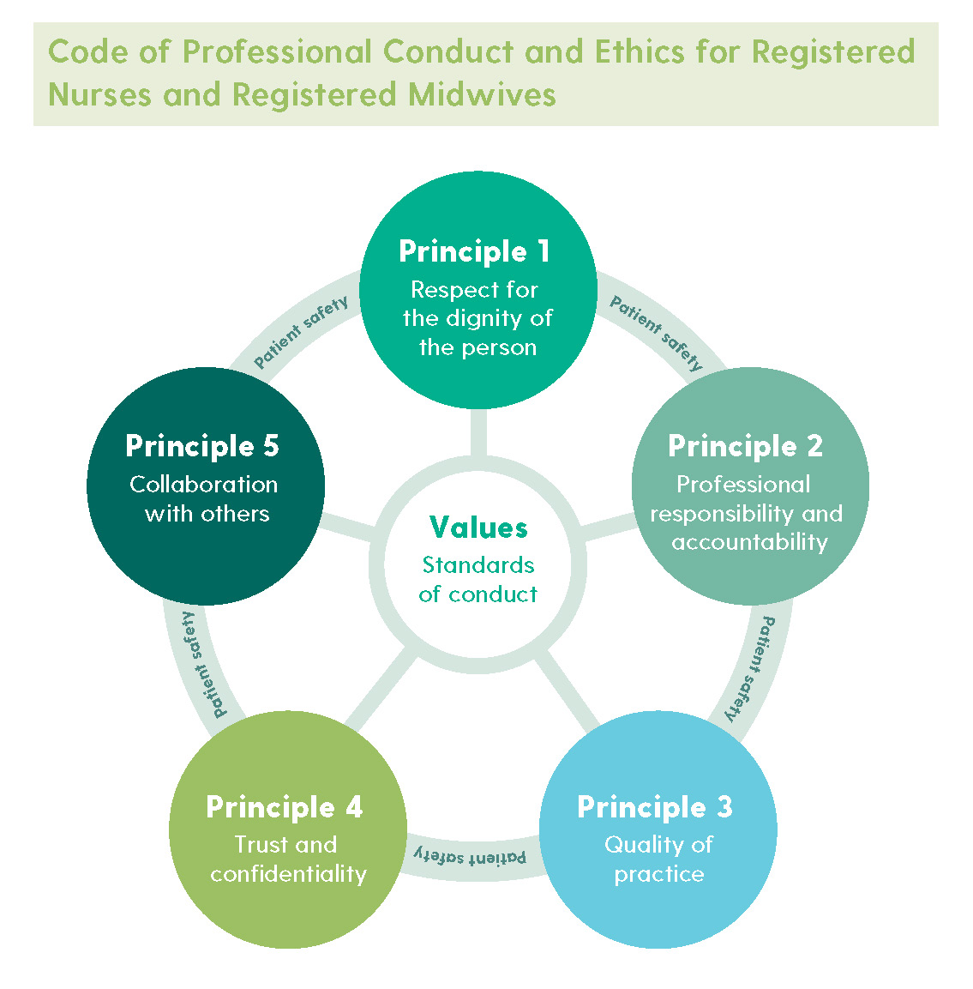


The Code and Midwifery Standards

Slide 9
Year 1 - Level of Supervision
Level and Description of Supervision | Scope of Practice
Direct Supervision: Defined as the Preceptor/Associate Preceptor (Co-preceptor) working with the student on a continuous basis whenever care is being provided to women and their babies. The student is expected to have observed and participated in practice with the Preceptor/Associate Preceptor (Co-preceptor) and be able to describe the care provided. | The student is a novice to the world of midwifery and requires exposure to all aspects of practice and direct supervision by the midwife. The student will be expected to have observed and participated in the care provided by the midwife to women in pregnancy and childbirth, and to mothers and babies in the postnatal period. The student should also be able to discuss the basic concepts involved. The student may require continuous prompting in the provision of midwifery care, and considerable direction in identifying their learning needs.

Slide 10
Year 4 - Level of Supervision
Level and Description of Supervision | Scope of Practice
Distant Supervision: Defined as the student safely and effectively performing the skill and providing care and accepting responsibility for the provision of this care. The student is expected at all times to recognise when they need assistance from the Preceptor/Associate Preceptor (Co-preceptor) and seek assistance in a timely manner. | The student will be expected to apply a systematic approach to the provision of midwifery care under distant supervision. The student must demonstrate evidence-based practice and critical thinking. The student is capable of supporting and monitoring women, their families and junior students within the clinical environment The student possesses many attributes including practical and technical skills, communication and inter-personal skills, organisational and managerial skills and the ability to practise as part of the healthcare team, demonstrating a professional attitude and accepting responsibility for their own practice. The student at all times is expected to recognise when they need assistance from the Preceptor/Co-preceptor and seek assistance in a timely manner.

Slide 11
Year 1 - Principle 1
Principle 1: Respect for the Dignity of the Person
Competency 1: The midwife’s practice is underpinned by a philosophy that protects and promotes the safety and autonomy of the woman and respects her experiences, choices, priorities, beliefs and values
LEVEL: DIRECT SUPERVISION | Assessment Criteria | Date & Sign Pass | Date & Sign Fail
1.1. Participates with the midwife in recognising pregnancy and childbirth as a healthy and normal physiological event and a profound event in a woman’s life. | Identifies how the physiological changes of pregnancy may affect the woman in her daily life.
1.2 Participates with the midwife in advocating on behalf of women and their babies to ensure their rights and interests are protected including the woman’s right to choose how and where to give birth. | Identifies the options and choices of maternity care available to women in their local health service area.
1.3 Participates with the midwife in respecting the diversity of women and their families including their beliefs, values, choices and priorities. | Identifies diversity and displays respect for beliefs values choices and priorities that may affect the provision of care.
1.4 Participates with the midwife in providing sufficient evidence-based information to the woman to empower her to make informed decisions about her care and that of her baby. | Uses appropriate language when providing information to a woman.

Slide 12
Year 4 - Principle 1
Principle 1: Respect for the Dignity of the Person
Competency 1: The midwife’s practice is underpinned by a philosophy that protects and promotes the safety and autonomy of the woman and respects her experiences, choices, priorities, beliefs and values
LEVEL: DIRECT SUPERVISION | Assessment Criteria | Date & Sign Pass | Date & Sign Fail
1.1 Promotes and protects pregnancy and childbirth as a healthy and normal physiological event and a profound event in a woman’s life. | Utilises health promotion opportunities to promote pregnancy as a healthy and normal physiological event
1.2 Advocates on behalf of women and their babies to ensure their rights and interests are protected including the woman’s right to choose how and where to give birth. | Ensures that informed consent is obtained from the woman by all health care professionals before any procedures are carried out. Promotes options and choices of maternity care for women based on current evidence.
1.3 Respects the diversity, beliefs, values and choices and priorities of the woman and her family. | Assesses, plans, implements and evaluates culturally sensitive care on an individual basis.
1.4 Provides the woman with sufficient evidence-based information to empower her to make an informed decision about her care and that of her baby. | Provides the woman with sufficient evidence-based information to empower her to make an informed decision about her care and that of her baby.
1.5 Respects the woman’s right to choose not to avail of a recommendation about her care and take appropriate action. | Demonstrates support for women’s choices, and aims to respect their rights while informing them of best practice. Accurately documents all information and care provided.

Slide 13


Issues identified
Organisational change for HEIs and clinical environment
New ways of working for NMBI, HEIs and clinical sites
Concern re loss of identity
Need for regular evaluation particularly as new standardised approach
A working document

Slide 14

Challenges encountered
Issues of academic governance which each HEI addressed individually
Time (no pilot)
Variations from HEI to HEI regarding clinical placements
Variations from HEI regarding discontinuation from the programme for failure to met required level of competency (failure to fail)
Agree standard format for the tool
Agree wording of each competency and to ensure each competency demonstrated incremental growth from year to year

Slide 15

Going forward
Working in progress
Evolving process
Responding to change
New way of working for NMBI, HEIs and clinical environment
Collaboration
Consultation

Slide 16


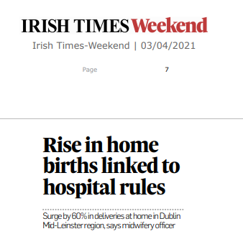
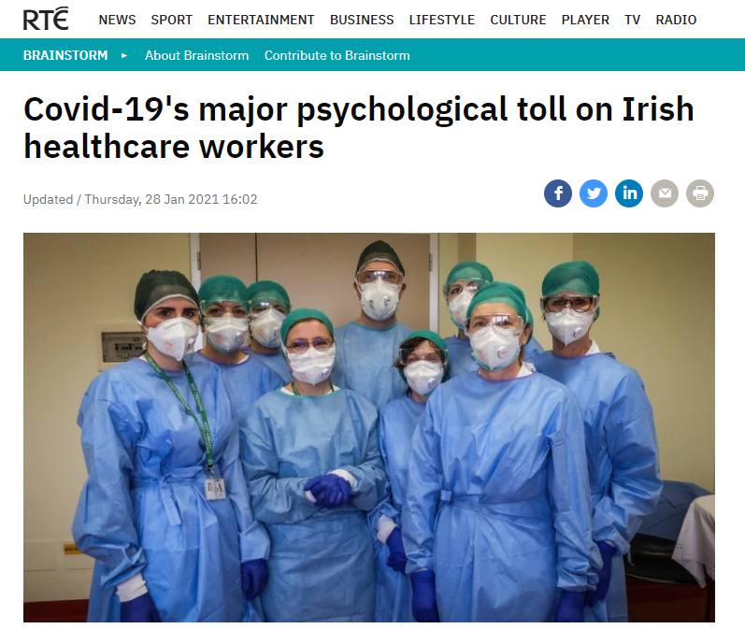
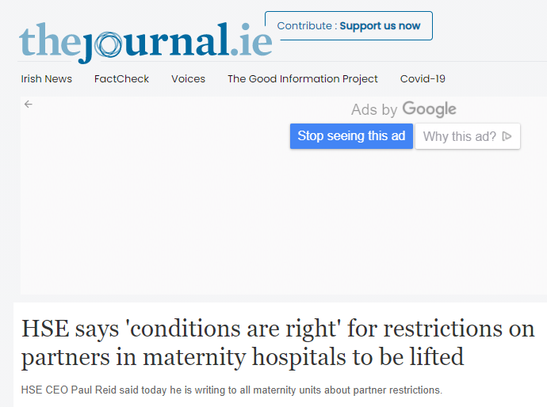
Covid-19

Slide 17
Thank you to the Team
Trinity College Dublin and Rotunda Hospital
Prof Joan Lalor
Ms Mary O’Reilly
University College Limerick and University Hospital Limerick
Ms Carmel Bradshaw
Dr Sylvia Tighe
Ms Mary Doyle
Ms Bernadette Toolan
Dundalk Institute of Technology(DkIT) and OLOL Hospital
Dr Kathleen Nallin
Ms Aoife O’Connor
Others
Ms Catherine Woods – newly qualified midwife
Dr Denise Lawler Board Member NMBI
Ms Dawn Johnston Director of Midwifery NMBI
Ms Georgina Farren Professional Officer NMBI
University College Dublin and National Maternity Hospital
Ms Barbara Lloyd Shanahan
Ms Lucille Sheehy
University College Cork and Cork University Maternity Hospital
Dr Geri McLaughlin
Ms Breda Bird
National University of Ireland Galway and University Hospital Galway
Ms Samantha Mulroney
Ms Mary O'Hara
Ms Ann Fallon
Ms Margaret Coohill
Ms Barbara Bradley
Ms Carmel Cronolly

Slide 18
djohnston@nmbi.ie dlawler@hiqa.ie
Thank you

