Slide 1
NMBI presentation
Inclusive Nursing & Midwifery Curriculum as a Pathway to Inclusive Patient Care
Sheila McClelland (she/her)

Slide 2
Overview
NMBI: who we are and what we do – working to be an inclusive regulator
Creating inclusive care
Creating inclusive education - current guidance:
  – ‘The Code’
  - standards and requirements
Opportunities and next steps

Slide 3
NMBI: who we are and what we do

Slide 4
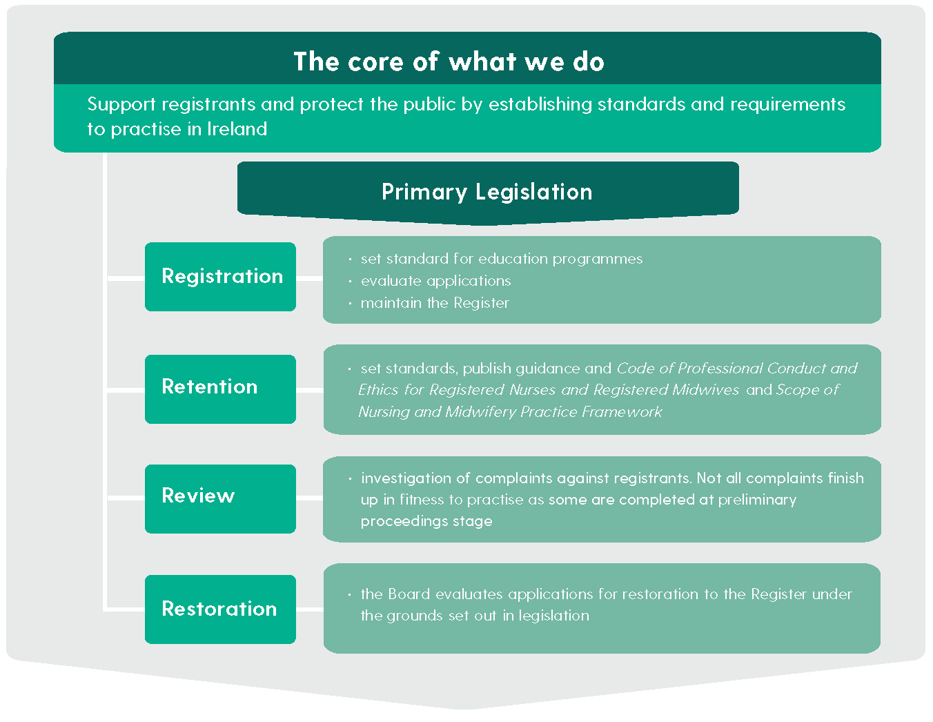
NMBI – Our values and our mission
We are
the regulatory body for
the professions of NURSING and MIDWIFERY
in Ireland
Our Vision
is to provide leadership to registered nurses
and midwives in delivering safe care through innovative and proactive professional regulation.
Our Mission
is to protect the public and the integrity of the professions of nursing and midwifery through the
promotion of high standards of education, training,
and professional conduct.

Slide 5
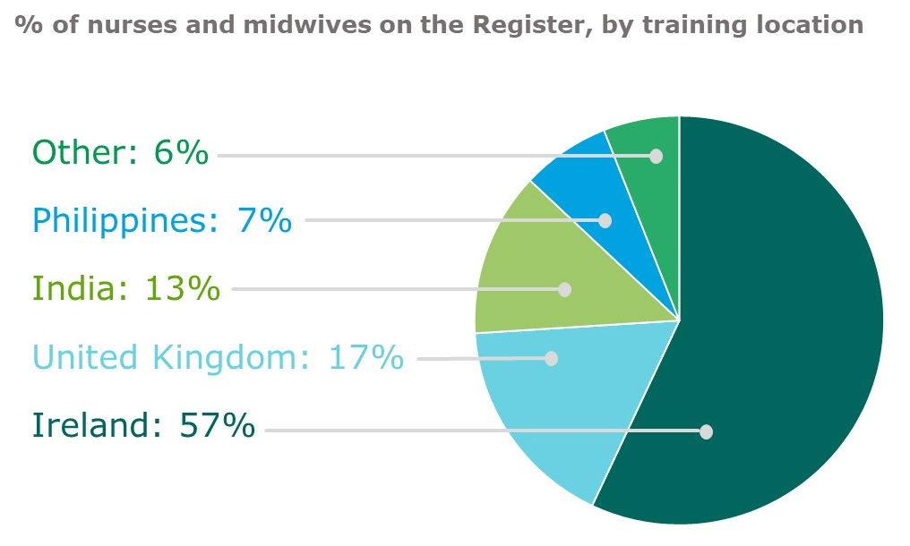
NMBI - divisions of the Register
79,027 nurses and midwives on the Register
Each nurse can be registered in one or multiple divisions of the Register
Division
General Nurses
Midwives
Children's Nurses
Psychiatric Nurses
Intellectual Disability Nurses
Public Health Nurses
Nurse Tutors
Midwife Tutors
Nurse Prescribers
Midwife Prescribers
Advanced Nurse Practitioners
Advanced Midwife Practitioners
Pre-registration
Post-registration

Slide 6
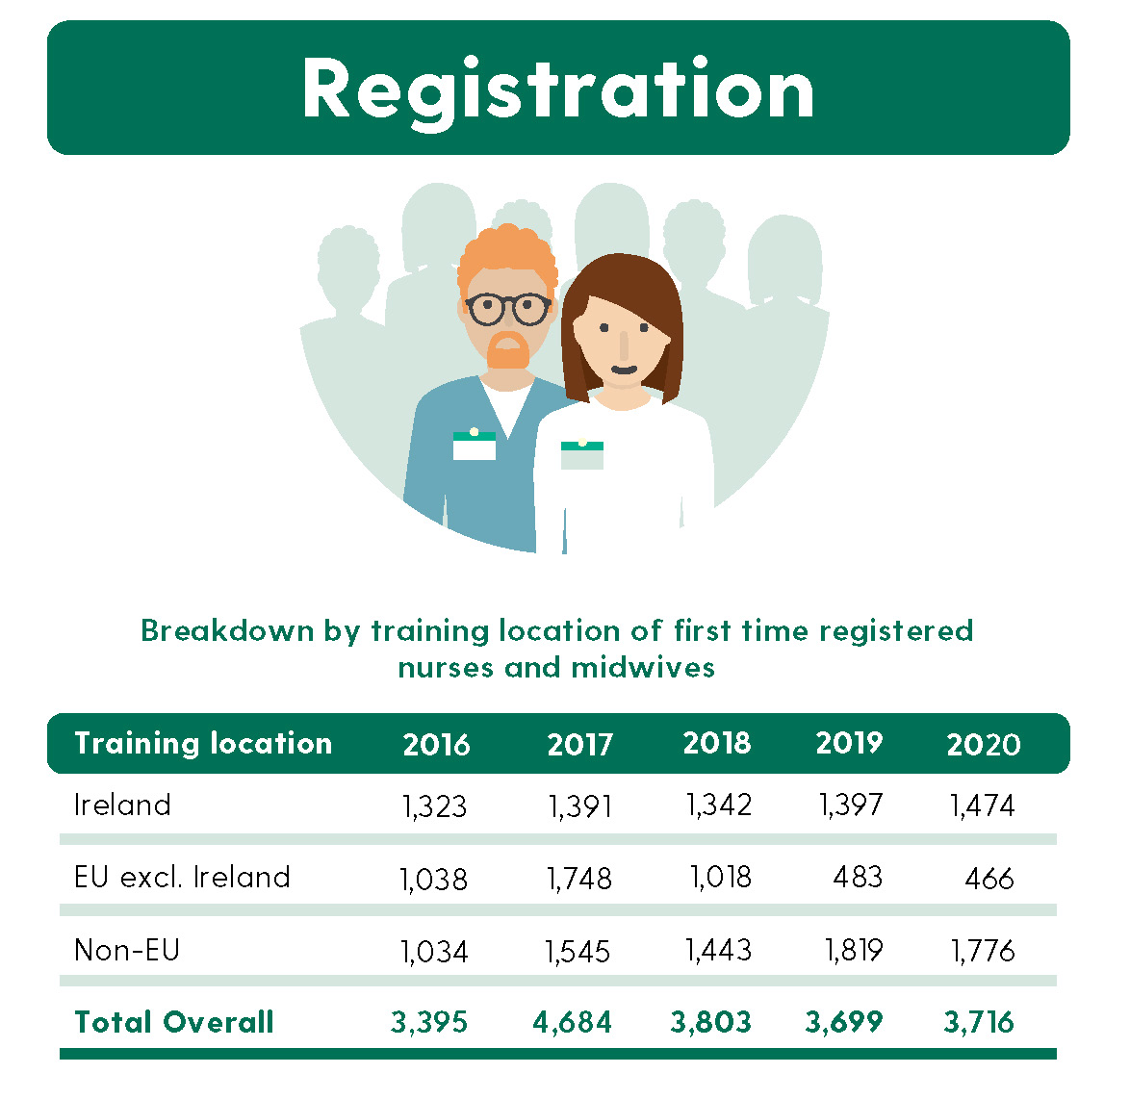
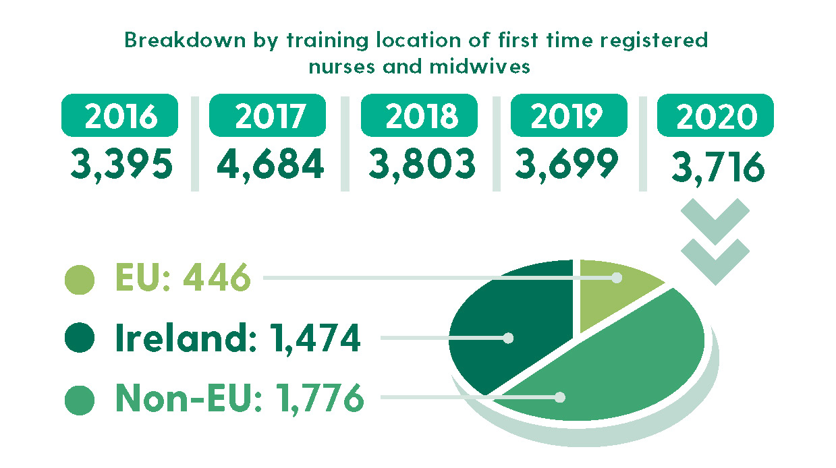
NMBI - newly qualified registrations 2016 - 2020

Slide 7
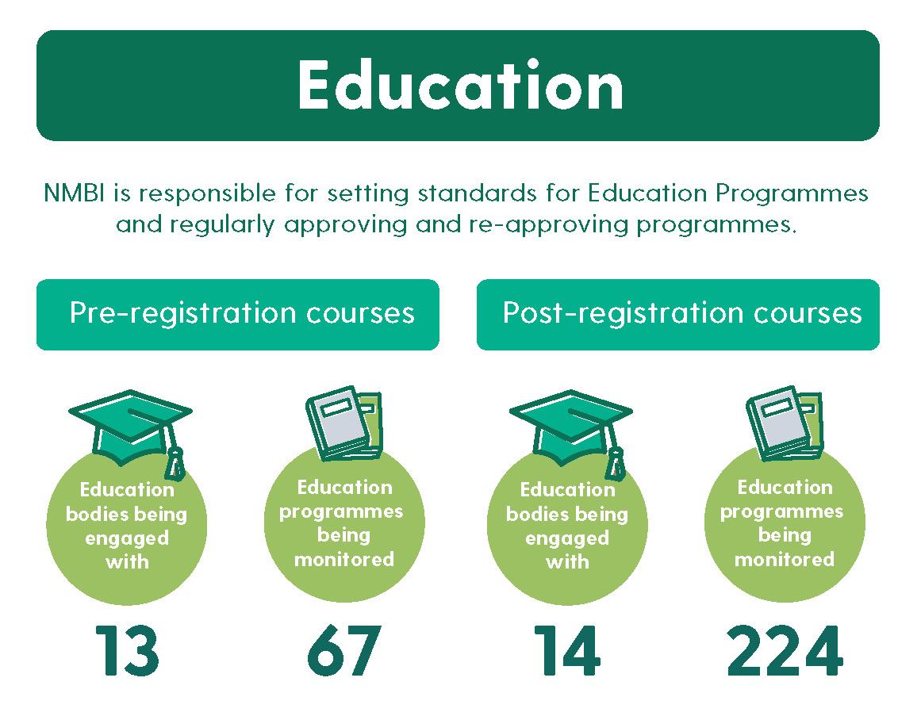
NMBI and higher education

Slide 8
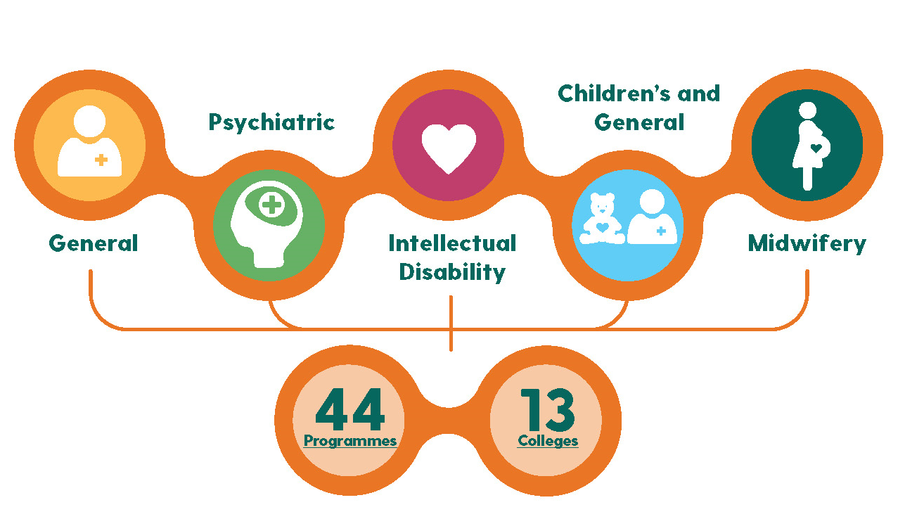
NMBI and higher education
13 HEIs and 44 programmes
1,832 places available annually
10,072 applications in 2021
  (highest number since introduction of degree programme in 2002)
  2281 mature applications to nursing and midwifery - 43% increase and the highest number of applications in five years.

Slide 9

NMBI – working to be an inclusive regulator
  NMBI is actively working to be more inclusive.
  Committed to creating an environment that promotes diversity and inclusion among our workforce and eliminates discrimination.
  We are finalising a Diversity and Inclusion policy to:
  provide fairness, and respect for all in our employment.
  not unlawfully discriminate under the characteristics of gender, civil status, family status, sexual orientation, religious belief, age, disability, race, or membership of the Traveller community.
  oppose and avoid all forms of unlawful discrimination
  Staff undertook diversity and inclusion training in 2020.

Slide 10
Creating inclusive care

Slide 11

Inclusive care - National LGTBI+ Inclusion Strategy 2019 - 2021
“Ensuring LGBTI+ people can fully and equally avail of mainstream health services”
“Eliminate barriers that may currently prevent LGBTI+ people from accessing health and social services due to a lack of understanding of their specific needs and a lack of targeted
service promotion”
“Aim to reduce barriers to access to health services and to improve health outcomes for the LGBTI+ community”

Slide 12

Inclusive care - National LGTBI+ Inclusion Strategy 2019 - 2021
The strategy outlines the need for healthcare providers and practitioners to be:
“trained to understand the identities and needs of their LGBTI+ patients and to avoid making heteronormative assumptions”.

Slide 13

Inclusive care - LGBTI+ National Youth Strategy 2018-2020
During the consultation process, young people highlighted challenges relating to health and wellbeing of LGBTI+ young people.
“a frustration regarding the sometimes-limited knowledge and understanding of LGBTI+ issues by healthcare personnel, and a limited availability of relevant LGBTI+ health information.”
The strategy outlines the need to ensure “that all healthcare staff receive LGBTI+ awareness training”

Slide 14
Creating inclusive education - current guidance: ‘The Code’

Slide 15
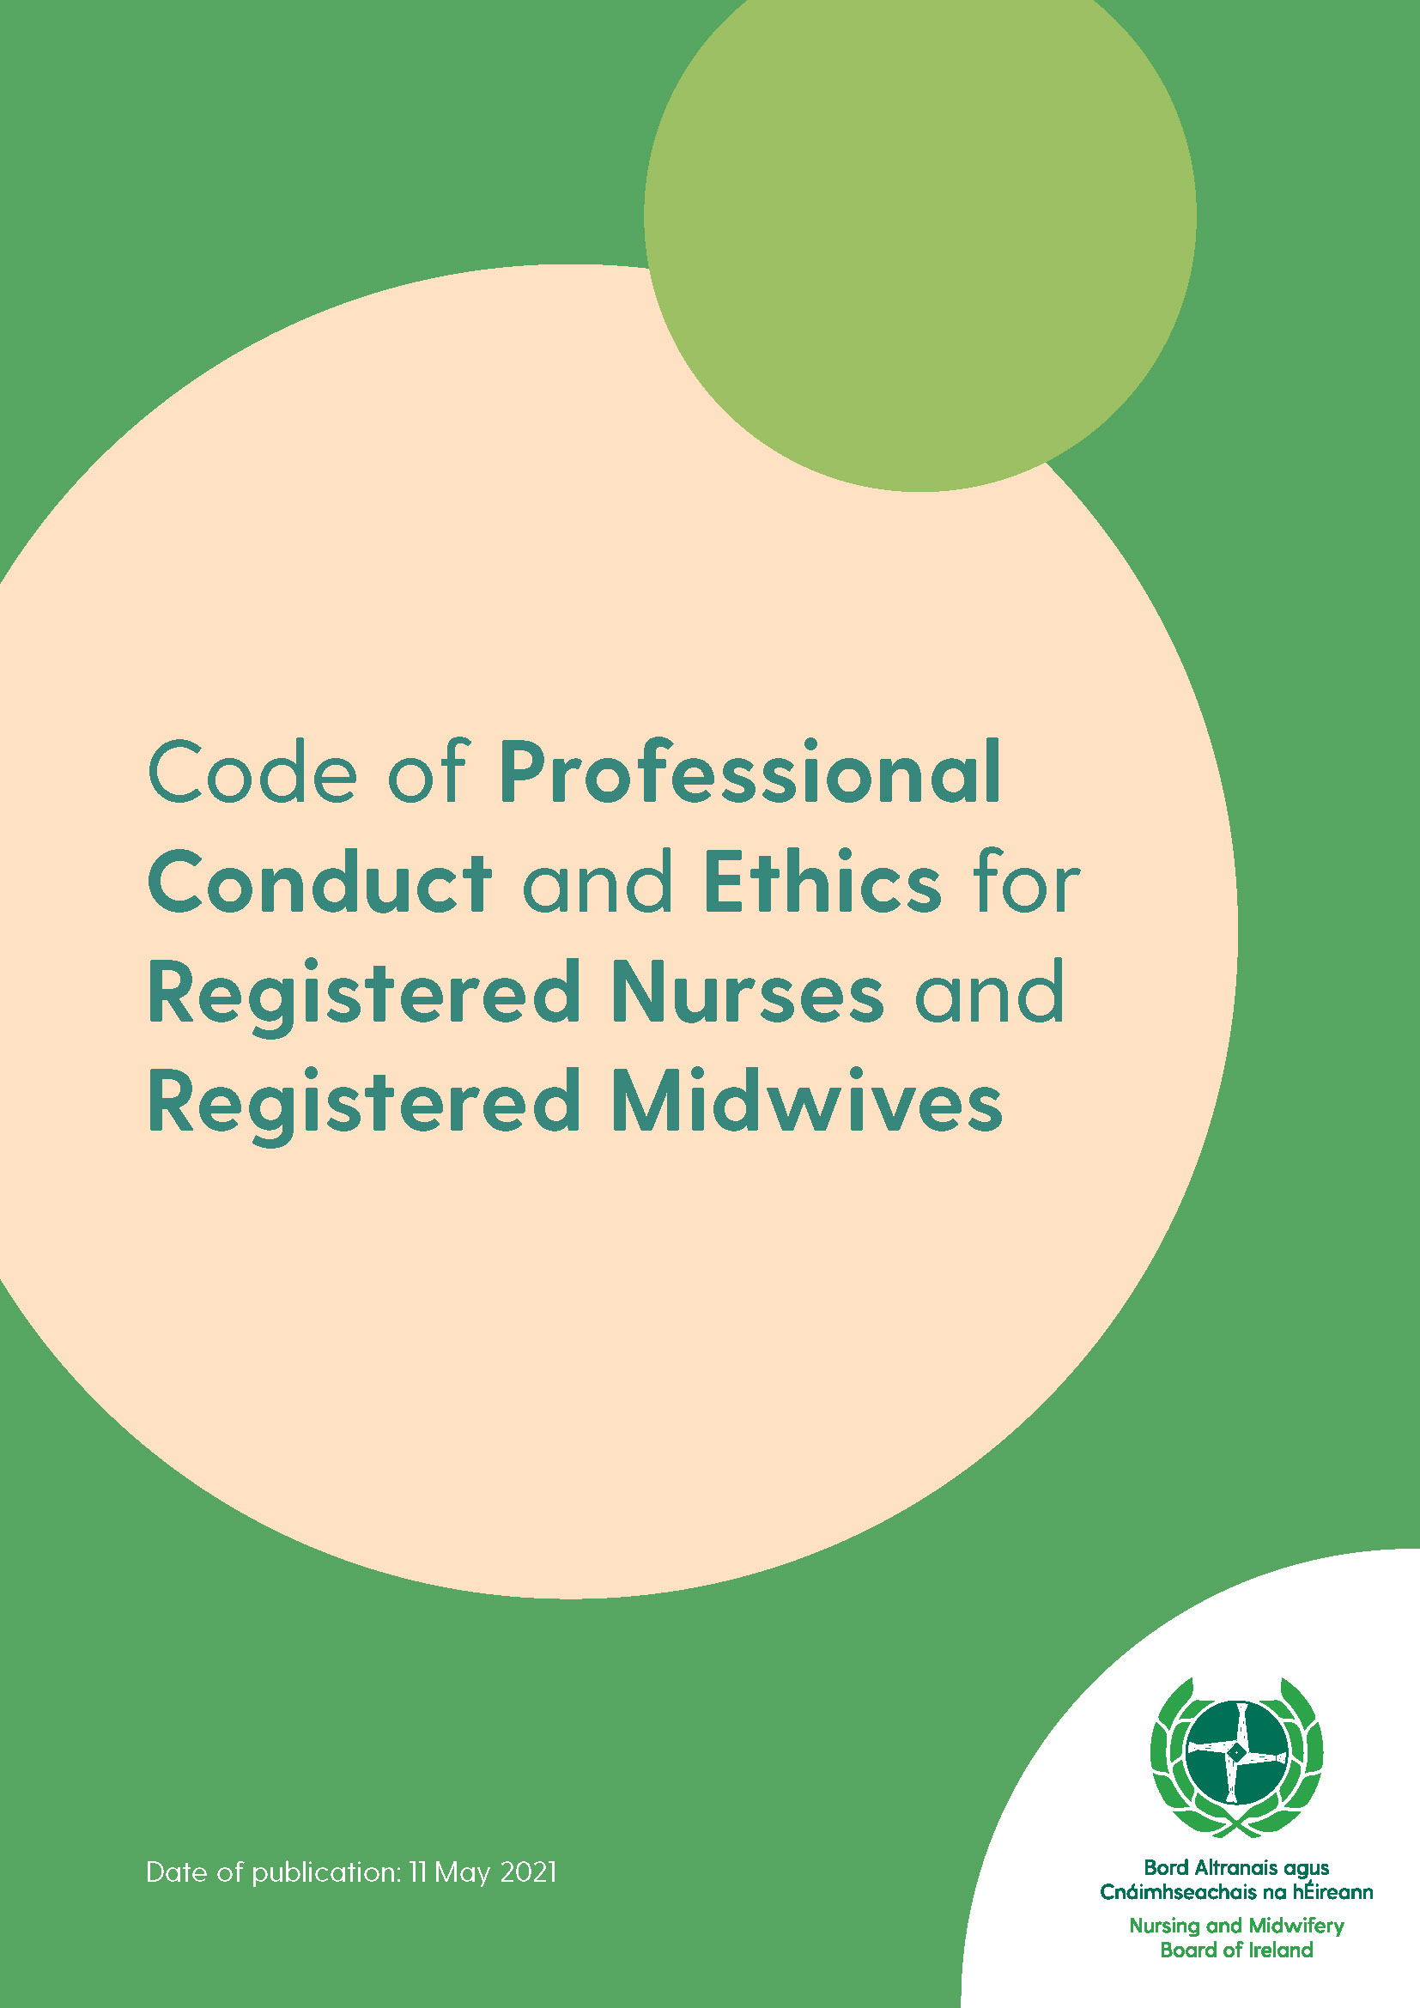
‘The Code’ - Code of Professional Conduct and Ethics for Registered Nurses and Registered Midwives
The purpose of ‘The Code’ is to:
guide nurses and midwives in their day-to-day practice
and
help them understand their professional responsibilities in caring for patients in a safe, ethical and effective way.

Slide 16
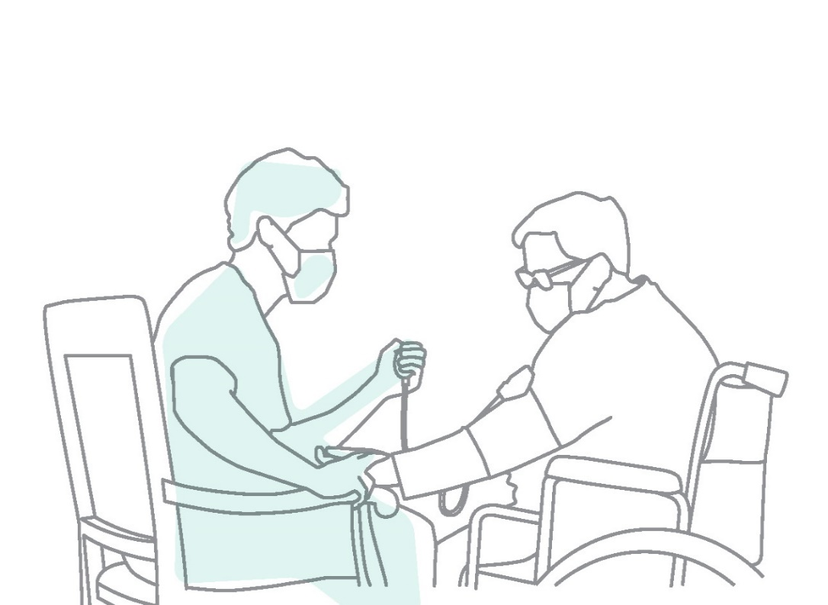
‘The Code’
All registered nurses and midwives in all areas of practice should adhere to the Code’s principles, values and standards of conduct.
The Code contains many principles consistent with the need for nurses and midwives to acknowledge and address the pertinent and unique healthcare needs of LGBTQ+ people.

Slide 17

‘The Code’: Principle 1 – Respect for the dignity of the person.
Drawn from the Universal Declaration of Human Rights (United Nations, 1948) which recognises the inherent dignity and equality of human beings.
Value 1 - that nurses and midwives respect each person as a unique individual.
Value 4 - that nurses and midwives respect each person’s right to self-determination as a basic human right.

Slide 18

‘The Code’: Principle 1 – Respect for the dignity of the person.
Value 5 - that nurses and midwives respect all people equally without discriminating on the ground of age, gender, race, religion, civil status, family status, sexual orientation, disability (physical, mental or intellectual) or membership of the Traveller community.

Slide 19

‘The Code’: Principle 2 – Professional responsibility and accountability
Value 4 - that nurses and midwives advocate for patients’ rights.
Standard of Conduct 6 under this principle states:
“you should act as an advocate on behalf of patients who require you to do so to ensure their rights and interests are protected”.

Slide 20
Creating inclusive education - current guidance: standards and requirements

Slide 21
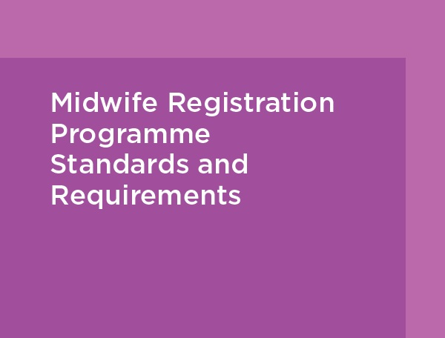

Registration programmes standards and requirement
Provide guidance for Higher Education Institutions (HEIs) and health service providers for the education of registered nurses and midwives.
For the development of flexible, innovative, practice-oriented registration programmes.

Slide 22

Nurse registration programmes standards and requirement
Learning outcomes and indicators by year of study - communication and interpersonal competences:
“On completion of the final practice placement for the FIRST year of the programme, the student will be able to….discuss the principles of cultural diversity, dignity and autonomy in establishing a collaborative partnership with a person.”

Slide 23
Nurse registration programmes standards and requirement
Professional values and conduct of the nurse competences - practise compassionately:
Consistently support the person across the life continuum through practice that is caring, kind, sensitive, holistic, impartial, and non-judgmental
Demonstrate respect for the diversity, dignity, integrity and uniqueness of the person through a collaborative partnership that recognises her/his autonomy.

Slide 24
Nurse registration programmes standards and requirement
Core indicative content: “Knowledge of how to support and promote health, wellbeing, rights and dignity of people, groups, communities and population.”
Standards in relation to curriculum design and development.
Indicator 6: The programme of study demonstrates that the delivery of person-focused nursing care respects the dignity, autonomy, and right of the person receiving care to make health and life choices as integral, explicit and
continuing elements with the curriculum.

Slide 25
Nurse registration programmes standards and requirement
Standards in relation to curriculum design and development.
Indicator 6: The programme of study demonstrates that the delivery of person-focused nursing care respects the dignity, autonomy, and right of the person receiving care to make health and life choices as integral, explicit and continuing elements with the curriculum.
Standards in relation to programme governance and management
Indicator 11: A policy for dignity and respect towards and between nursing students, clinicians, persons receiving healthcare and
academic staff is in place.

Slide 26

Midwife Registration Programme Standards and Requirements
Indicative content of the programme -
Knowledge base for midwifery practice: psychology as applied to midwifery practice
“A fundamental introduction to psychological theory, research, principles and processes and their application to midwifery which includes:
relationships and family, sexuality, social psychology, organisational psychology.”

Slide 27
Opportunities and next steps

Slide 28
Opportunities and next steps – NMBI’s role
At NMBI we:
have structures and guidance in place to create inclusive education - ‘The Code’ and standards and requirements
but
are conscious we need a LGBTQ+ lens on the work we do and how we develop standards and requirements
and
need to consciously monitor it, ensure it is a living breathing reality - which ensures people feel actively included.

Slide 29

Opportunities and next steps – inclusive consultation
Consultation is a regular feature of our work at NMBI
As we continue to draft and develop standards, guidance etc. we will ensure inclusive consultation.
We will be asking for your views, and you will be included in our stakeholder engagement and communications.
At NMBI we always welcome feedback and are open to it – please contact us.

Slide 30
Opportunities and next steps
Study the research from Michael Brown and Freda McCormick in the context of NMBI standards and guidance.
Consider further stakeholder engagement on this issue in relation to NMBI’s existing documents - ‘The Code’ and the Nurse and Midwife Registration Programmes Standards and Requirements.

Slide 31
Thank you
www.nmbi.ie

